Slide 1
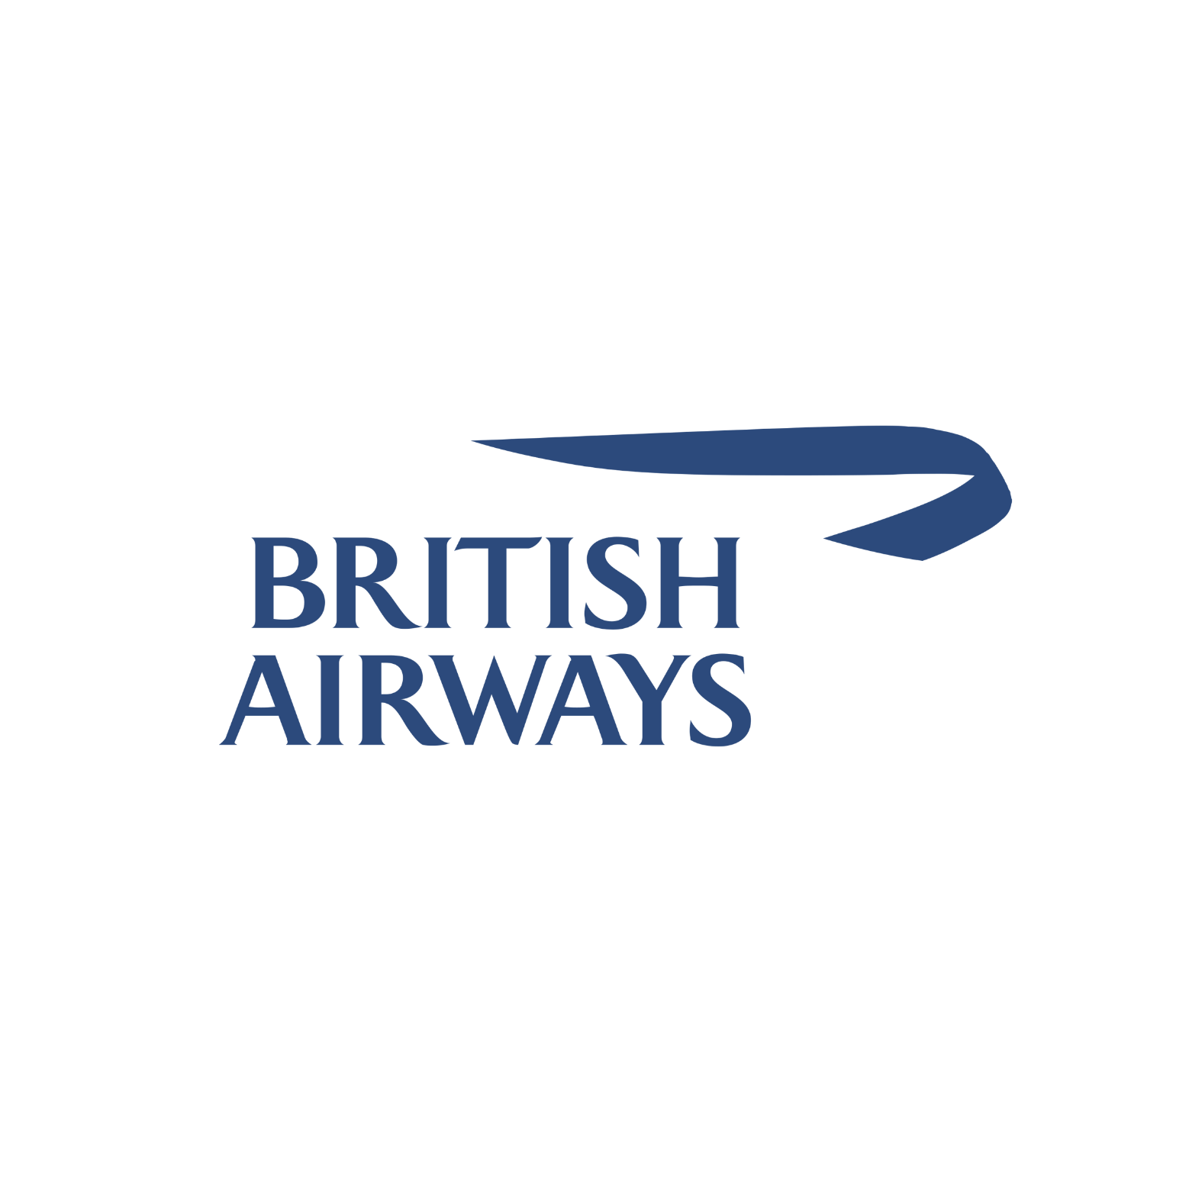
BRITISH AIRWAYS CUSTOMER BOOKING MODELLING TO GAIN INSIGHTS
NATHANAEL MUTUA – ASPIRING DATA ANALYST

Slide 2

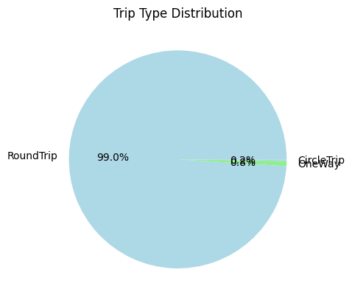
INSIGHTS BASED ON TRIP TYPE (exploration)
Round Trips are 49497.
Circle Trips are 116.
One Way Trips are 387.
This is a general overview of the trip distribution and customer preference based on trip type.
NATHANAEL MUTUA – ASPIRING DATA ANALYST

Slide 3
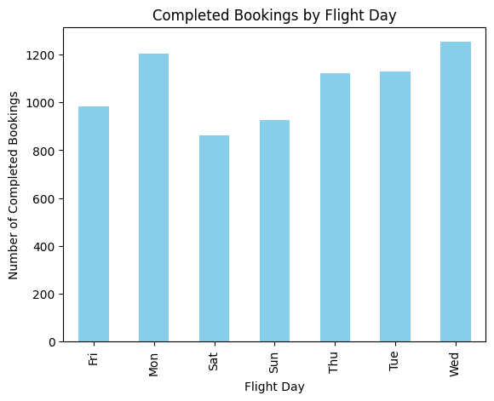
INSIGHTS BASED ON DAY OF TRAVEL (exploration)
Monday had 8102 occurrences.
Tuesday had 7673 occurrences.
Wednesday had 7674 occurrences.
Thursday had 7424 occurrences.
Friday had 6761 occurrences.
Saturday had 5812 occurrences.
Sunday had 6554 occurrences.
This is a general overview based on the day of flights made.
It gives a vague analysis. The distribution is more or less evenly spread across the week.
NATHANAEL MUTUA – ASPIRING DATA ANALYST

Slide 4
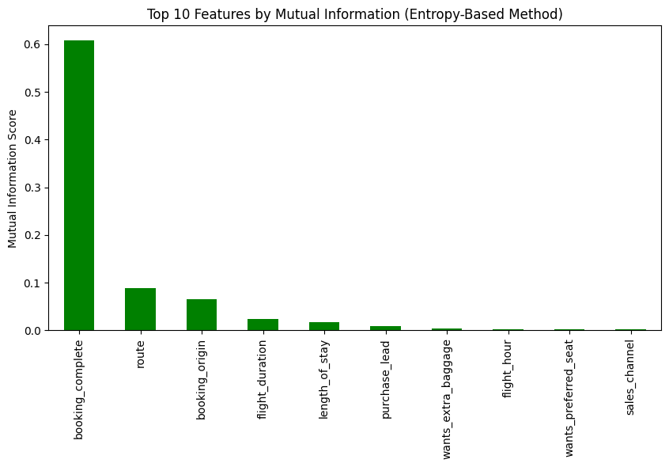
INSIGHTS BASED ON MUTUAL INFORMATION
Mutual Information (MI) helps us understand which features strongly influence whether a customer completes a booking.
Certain flight routes may have a higher likelihood of bookings (e.g., major hubs vs. less popular destinations).
Some countries/regions may have higher conversion rates due to travel demand, pricing, or local market preferences.
Customers may prefer shorter flights over long-haul flights, impacting booking rates.(flight_duration)
Whether customers book via mobile app, website, or travel agencies might affect the likelihood of completing a booking.(sales_channel)
Business travelers may book more reliably than leisure travelers.(trip_type)
Certain day of the week may influence booking behavior.
NATHANAEL MUTUA – ASPIRING DATA ANALYST

Slide 5
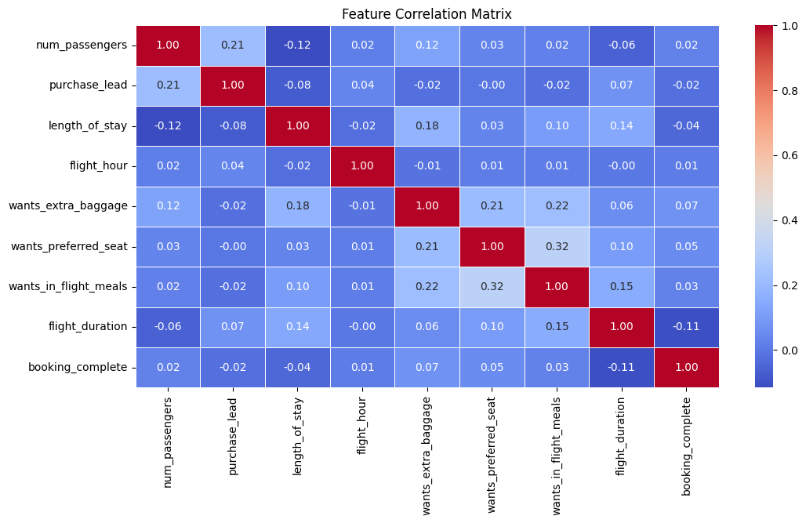
INSIGHTS BASED ON CORRELATION MATRIX
Customers who opt for a preferred seat are also more likely to order in-flight meals.
This suggests a premium traveler segment that values comfort and convenience.
As British Airways we can bundle preferred seating + meal options to encourage higher revenue per passenger.
Targeted marketing: Offer meal discounts or upgrades to customers booking preferred seats.
A negative correlation suggests that longer flights may slightly reduce booking completion rate. Customers might hesitate to book longer flights due to higher costs, travel fatigue, or layovers.
Optimize pricing: We can offer discounts or loyalty perks for long-haul routes to encourage bookings. Improve customer experience: By enhancing long-haul in-flight services (e.g., better entertainment, extra legroom) to increase conversion rates.
NATHANAEL MUTUA – ASPIRING DATA ANALYST

Slide 6
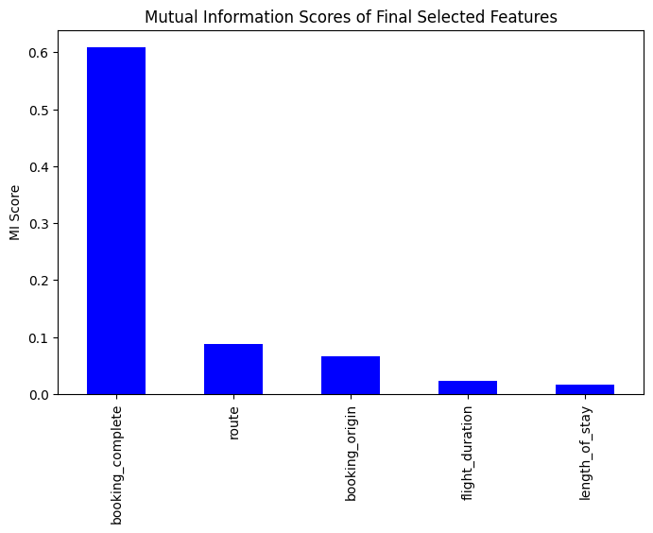
INSIGHTS BASED ON MI SCORE OF FINAL SELECTED FEATURES
Route and booking_origin have high MI scores compared to other variables. This implies that a customer’s travel route and where they are booking from play a crucial role in whether they will complete booking.
Personalization strategies: Offer tailored deals based on the customer's location (e.g., discounts for travelers from certain countries).
NATHANAEL MUTUA – ASPIRING DATA ANALYST

Slide 7
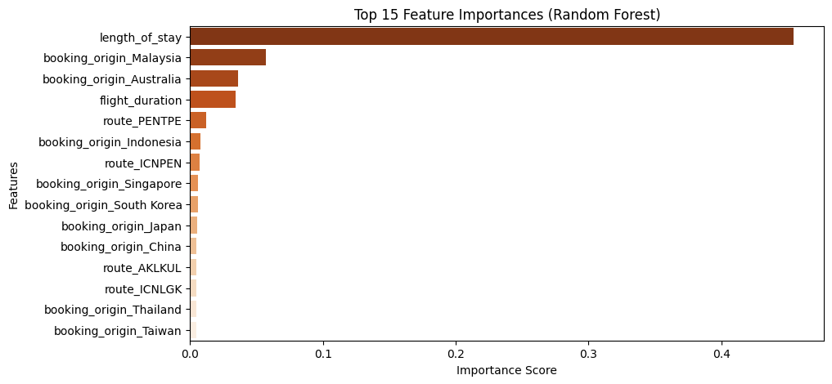
INSIGHTS BASED ON DAY OF TRAVEL
Here length_of_stay has the highest importance, it suggests that longer stays correlate with a higher likelihood of booking completion.
Travelers who plan longer stays may be more committed to their trip and less likely to cancel compared to those booking shorter stays.
Encourage longer stays by offering discounts, such as “Stay 3 nights, get the 4th night free.”
For shorter stays, consider flexible booking options, last-minute discounts, or loyalty program incentives to increase conversion rates.
NATHANAEL MUTUA – ASPIRING DATA ANALYST

